Slide 1
Banner 9 Training WVUP OIT

Slide 2
Presentation Overview:
Access Banner 9
Basic Navigation
Quick Overview of system changes from Banner 8 to Banner 9
System Button Functions
Keyboard Shortcuts
Accessing Content:
Using the Menu
Using Search
Using Quick Access
Using Favorites
Searching for a user
Entering Data
2

Slide 3
Accessing Banner 9

Slide 4
Accessing Banner 9:
System Direct Link: http://www.wvup.edu/banner9
Login Information:
WVUP Network ID: (Same username you use to sign into your computer)
WVUP Network Password (Same password you use to sign into your computer)
Accessing the System Banner 9
4

Slide 5
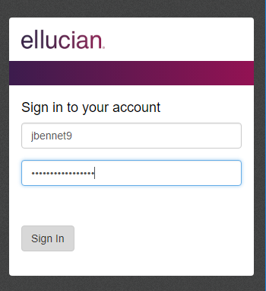
Accessing Banner 9:
WVUP Network ID
WVUP Network Password
5

Slide 6
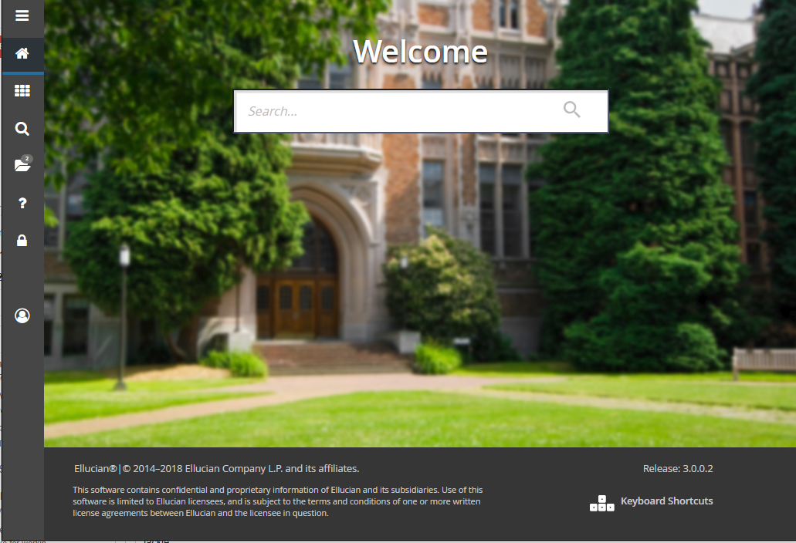
Accessing Banner 9: Main Menu
6

Slide 7
Basic Navigation

Slide 8
Banner 9 Navigation: Main Screen
Main Menu
Search
Help
Landing Page Search Box
8

Slide 9
Basic Changes from
Banner 8 to Banner 9

Slide 10
Changes from Banner 8 to Banner 9:
Banner 9 does not use Java and is not browser- restricted.
Forms are now referred to as pages
You can bookmark “Pages” as you would any other website.
Keyboard shortcuts are different.
Location of button is different.
Data is the SAME ☺
System Changes Banner 8 to Banner 9
10

Slide 11
System Buttons

Slide 12
System Buttons: Insert, Previous and Remove Record
12

Slide 13
System Buttons: Save and Rollback
13

Slide 14
Keyboard Shortcuts

Slide 15
Keyboard Shortcuts: Major Changes
 | Banner 8 | Banner 9
Next Section | CTRL +PAGE DOWN | ALT + PAGEDOWN
Open Quick Menu | F5 | CTRL + M
Print | SHIFT + F8 | CTRL + P
Rollback | SHIFT + F7 | F5
15

Slide 16
Accessing Content

Slide 17
Accessing Content in Banner 9:
There are 4 main ways to access content in the system:
Using the Menu
Using Search
Using Quick Access
Using Favorites ( My Banner )
Accessing Content in Banner 9
17

Slide 18
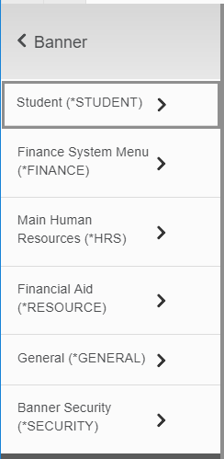
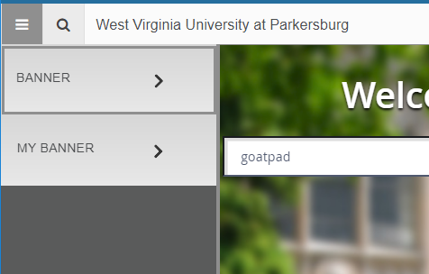
Access Content: Using the menu
My Banner can still be used and edited by accessing GUAPMNU.
18

Slide 19
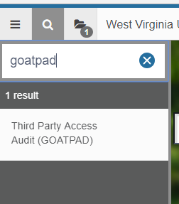
Access Content: Using Search
19

Slide 20
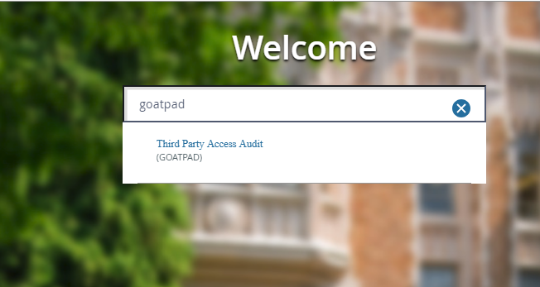
Access Content: Using Quick Access
20

Slide 21
Access Content: Using MY BANNER favorites
My Banner can still be used and edited by accessing GUAPMNU.
21

Slide 22
Searching for a user

Slide 23
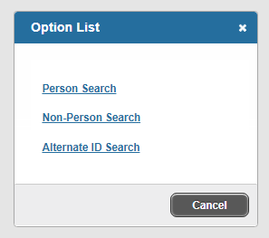
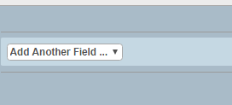
Access Content: Using MY BANNER favorites
23

Slide 24
Support

Slide 25
WVUP Support:
WVUP Support Overview:
Telephone: 304-424-8215
Submit a ticket: http://helpdesk.wvup.edu
Hours of Operation:
Monday – Friday: 8:00 A.M. to 10:00 P.M.
Hours subject to change due to major holidays and breaks between semesters.
WVUP Support WVUP OIT
25

